Slide 1
CSE 3218 - Lab2
Introduction to SwiftUI Elements
Repon Islam
Assistant Professor,
CSE, KUET
Kaniz Fatema Isha
Lecturer,
CSE, KUET

Slide 2
SwiftUI vs Storyboard
SwiftUI: Launched in 2019, uses declarative syntax.
SwiftUI introduces a declarative syntax that allows developers to define their user interfaces in terms of what they should display, rather than how to build them step-by-step

Slide 3
SwiftUI vs Storyboard
Storyboard: Part of UIKit, visual drag-and-drop interface.
It employs a visual interface for designing layouts, allowing developers to arrange UI elements through drag-and-drop interactions.

Slide 4
Class and Struct in Swift
Structs are Value Types
Classes are Reference Types
Almost every UI component is a Struct because they are incredibly fast to create and destroy.
But what is there that can be achieved with class but not with struct ?

Slide 5
Types of Properties: Stored
Stored properties are constants or variables that are stored as part of an instance of a class, structure, or enumeration
class MyClass {
var storedProperty: Int = 10
}

Slide 6
Types of Properties: Computed
A computed property does not store a value. Instead, it calculates a value every time we access it.
struct Track {
var distanceInMeters: Double
// Computed Property
var distanceInKilometers: Double {
return distanceInMeters / 1000}
}
var race = Track(distanceInMeters: 5000)
print(race.distanceInKilometers) // 5.0

Slide 7
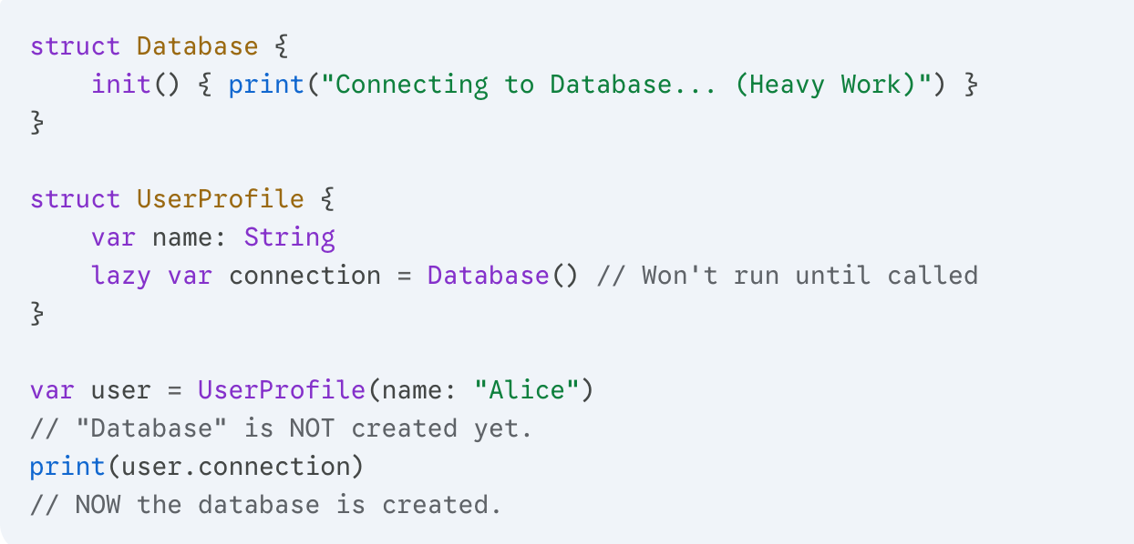
Types of Properties: Lazy
A lazy stored property is a property whose initial value is not calculated until the first time it is used.

Slide 8
Types of Properties: Type
Type properties belong to the type itself rather than instances of the type.
They are defined using the static keyword.
struct SpaceShip {
static let maxSpeed = 1000
var currentSpeed = 0 }
print(SpaceShip.maxSpeed)
let myShip = SpaceShip()
print(myShip.maxSpeed)

Slide 9
Protocol
A protocol defines a blueprint of methods, properties, and other requirements.
It doesn't provide the code (the how); it only defines the requirements (the what).
When a class or struct conforms to a protocol: the protocol says "You must be able to do X and Y," and the struct says "I'll do the job!"
Protocols allow us to treat different types as the same thing if they follow the same contract.

Slide 10
Environment and Code
For the rest, lets dive into coding !

Slide 11
Reference
https://medium.com/@mertaydogn0/swiftui-vs-storyboard-a-comprehensive-analysis-for-ios-development-edb8ec8ee566
https://medium.com/swiftfy/what-are-properties-in-swift-bc4f4735f913

